Slide 1
effect of weather stimuli and road points of interest in classifying traffic accident severity
Adithya Narayanan
Adit Bhargav Modi
Akhil Gaddipati

Slide 2
MOTIVATION

Slide 3
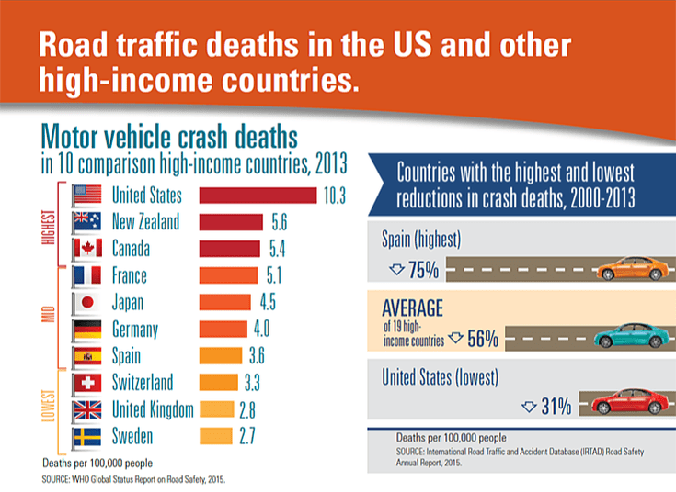
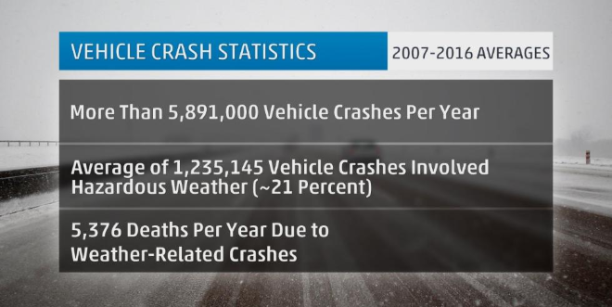

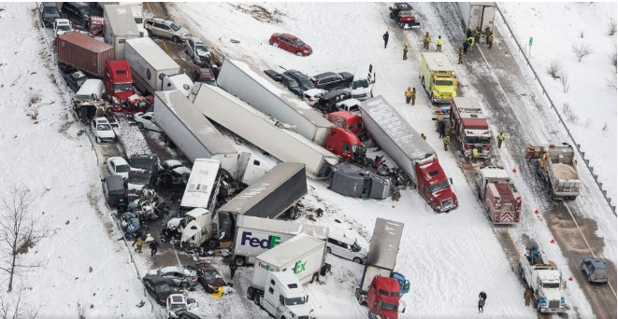
Note: neque in dignissim, and quet nis et umis varius.
https://weather.com/safety/winter/news/weather-fatalities-car-crashes-accidents-united-states
http://www.prism.engineering/traffic-facts-international-by-country.html
https://weather.com/safety/winter/news/weather-fatalities-car-crashes-accidents-united-states
https://www.nbcnews.com/tech/tech-news/self-driving-uber-car-hit-killed-woman-did-not-recognize-n1079281
Notes:
https://weather.com/safety/winter/news/weather-fatalities-car-crashes-accidents-united-states
http://www.prism.engineering/traffic-facts-international-by-country.html
https://weather.com/safety/winter/news/weather-fatalities-car-crashes-accidents-united-states
https://www.nbcnews.com/tech/tech-news/self-driving-uber-car-hit-killed-woman-did-not-recognize-n1079281

Slide 4
Problem Statement
Analyzing and modeling the effect that weather stimuli and road points-of-interest (POIs) bear on accident severity

Slide 5
Literature review

Slide 6
Past Work
Malin et al. (2019) analyzed accidents in Finland across all main road networks using Palm Probabilites by also accounting for driver behavior and found that both, road type and weather conditions, were found to have significant impact on accident severity.
Sherretz et al. (1978) analyzed the data from seven southern Illinois cities and found a linear relationship between rainfall and occurrence of traffic accidents.
The Montella et al. (2012) study analyzed two wheeler crashes in Italy. Alignment subsets such as intersection, curved roads and so on, were observed to be related to crashes. A lot of times, good weather did not bear any impact on crashes.
Moosavi et al. (2019) used deep neural networks to predict accident risks in real time- up to 15 minute durations within a precision of 5sq. Km radius using the same dataset.
Theoﬁlatos, A. (2017) did not find a strong relationship between weather and accident severity.
Notes:
The Montella et al [18] study analyzed two wheeler crashes in Italy. Alignment subsets such as intersection, curved roads and so on, were observed to be related to crashes. A lot of times, good weather did not bear any impact on crashes.

Slide 7
Methodologies from Past Work
Bayesian Logistic Regression
CART
Random Forest
SVMs, Neural Networks, Hybrid Decision Tree-NN methods
Multiple Objective Particle Swarm Optimization (MOPSO)
Pitfalls: Niche Data, leading to high bias and low variance across regions or climatic conditions- doesn’t capture all conditions well

Slide 8
DATA Description

Slide 9
Initial Data : US Accidents
2.25 Million Observations (obtained using APIs that provide traffic event data)
Spanning 49 states
Data collected from February 2016 to March 2019
49 columns including weather data and Road POIs
Certain variables such as Source, TMC, Start and End Times, Start and End Latitudes and Longitudes, and some other geographical variables were removed since they were not included in our primary scope of interest.
Variables containing more than 80% of missing values were also removed.
Variable of Interest: Severity
Level 1 : 2 Minutes and 30 Seconds (814)
Level 2 : 3 Minutes and 15 Seconds (1455524)
Level 3: 8 Minutes (715582)
Level 4: 18 Minutes (72002)
Moosavi et al.(2019)
Notes:
https://mapchart.net/usa.html

Slide 10
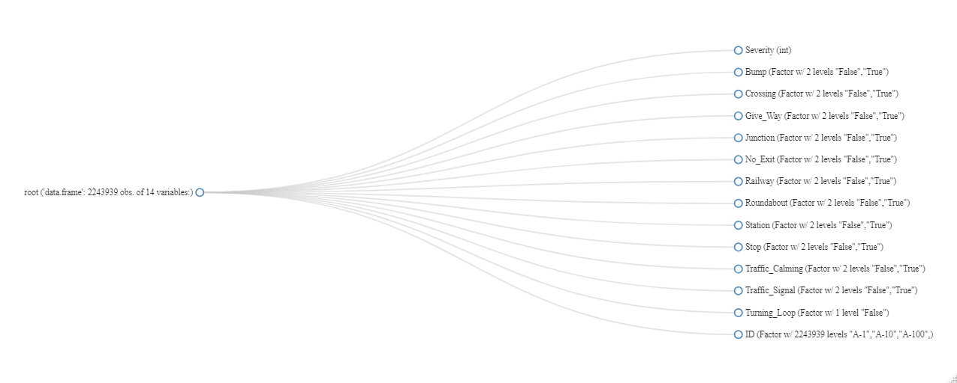
Road POIs

Slide 11
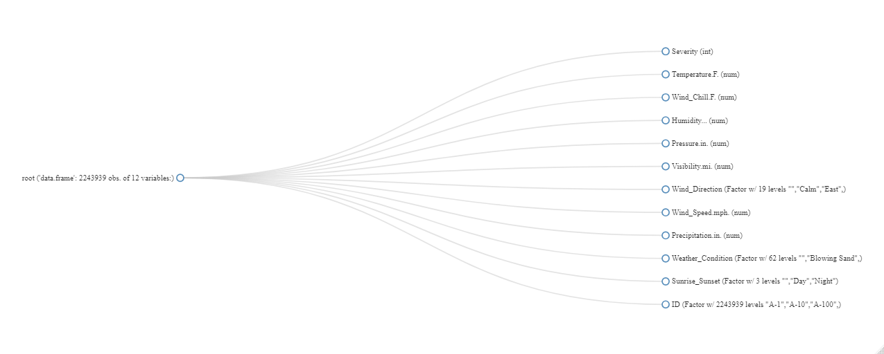
Weather Variables

Slide 12
Data preprocessing and cleaning

Slide 13
Data Preprocessing and Cleaning
US Accidents Data
2.25 Million observations
49 variables
Data Cleaning
Relevant Feature Selection
2.25 Million observations
~18 variables
Under Sampling
Subset
Data of Four Different States (Arizona, Washington, Florida, Pennsylvania)

Slide 14
Variables Considered
ROAD POIs~
Amenity
Crossing
Station
Stop
Give Way
Traffic Calming
Junction
No Exit
Traffic signal
Railway Crossing
Bump
Roundabout
WEATHER VARIABLES
Temperature
Wind Direction
Wind Speed
Humidity
Pressure
Visibility

Slide 15
MethodologY

Slide 16
State Subsets
Training Data
Logistic Regression
ClassificationTree
AdaBoost
MARS
Bagging
Random
Forest
Tuning Prediction
Threshold
10 Fold Cross-Validation with 3 replications
Tuning of Predictors and Trees
Test Data
Test Data
Test Data
Predictive
Accuracy
Predictive
Accuracy
Predictive
Accuracy

Slide 17
RESULTS

Slide 18
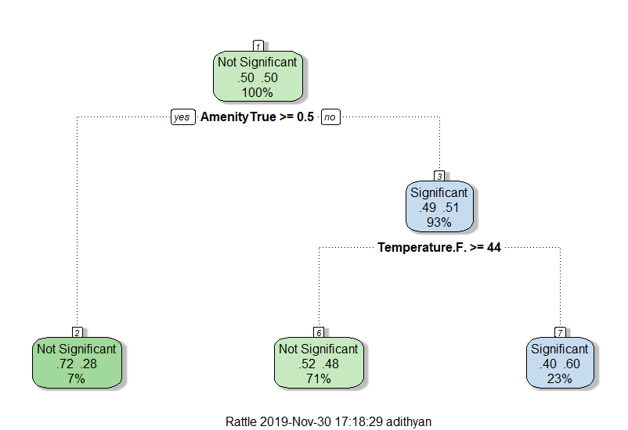
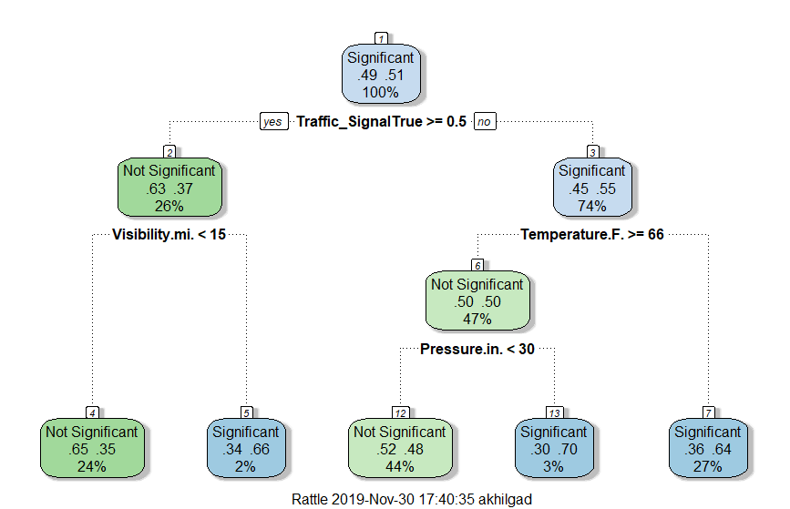
Classification Trees
Washington
Arizona

Slide 19
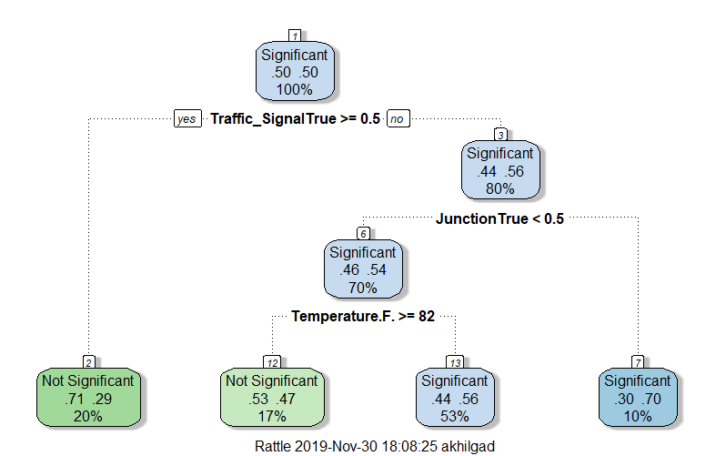
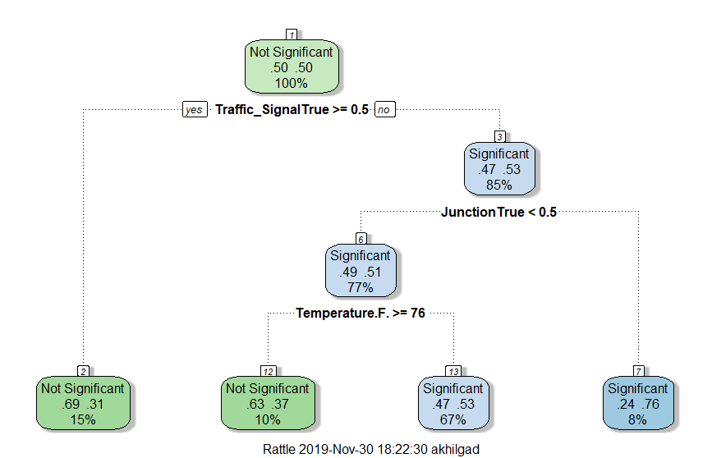
Classification Trees
Florida
Pennsylvania

Slide 20
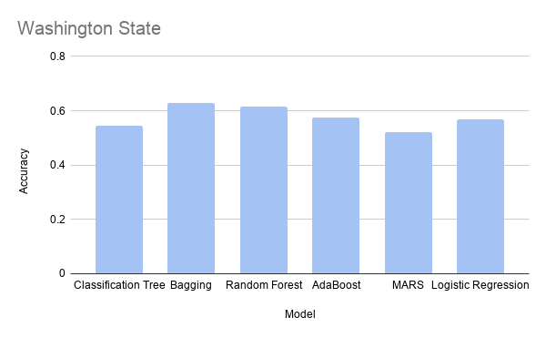
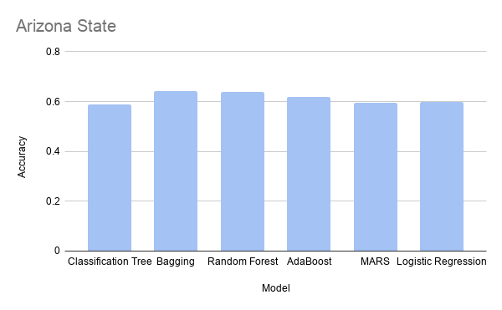
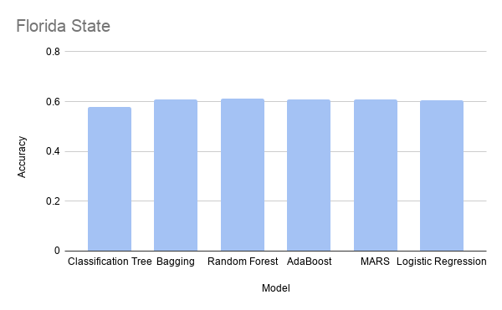
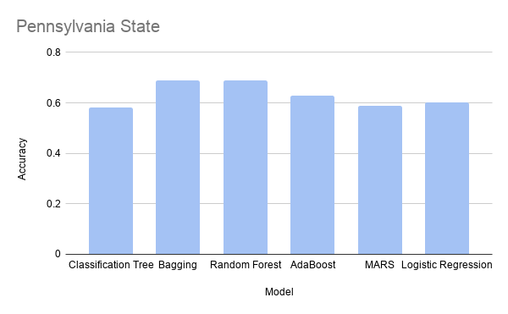
Predictive Accuracy

Slide 21
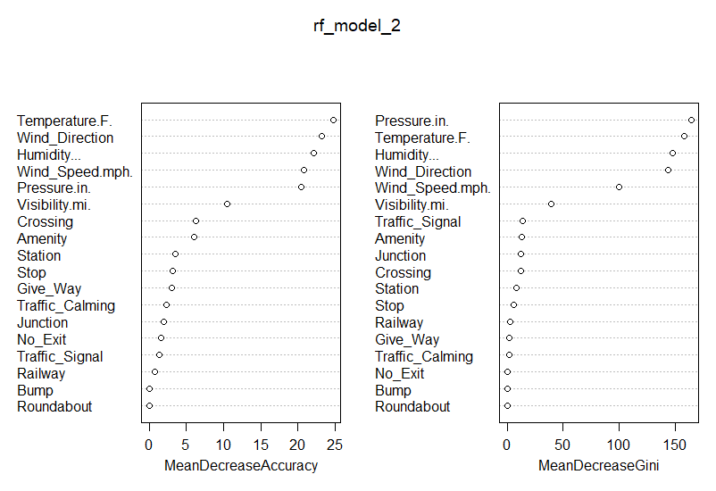
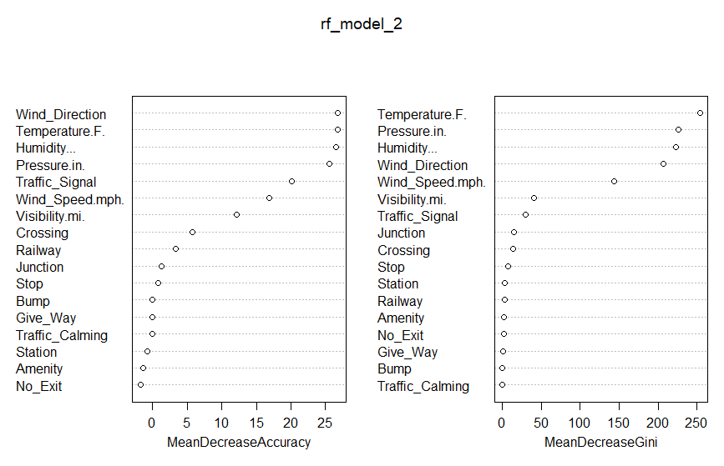
Classification Trees
Washington
Arizona

Slide 22
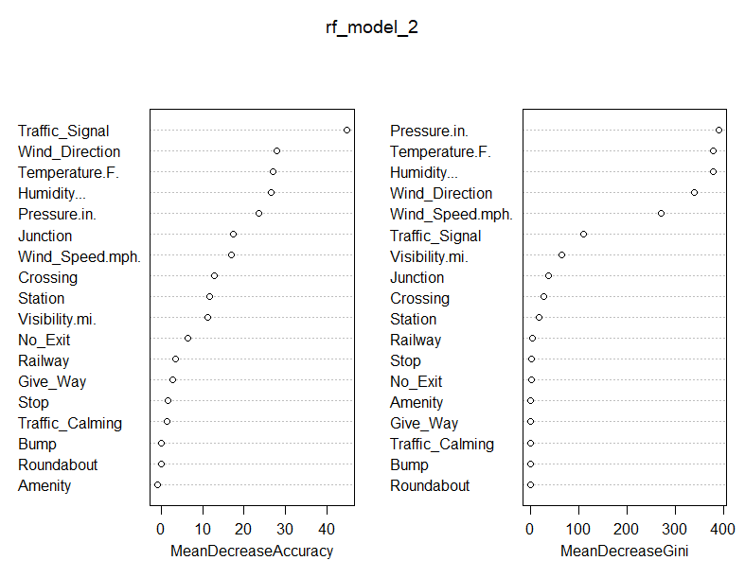
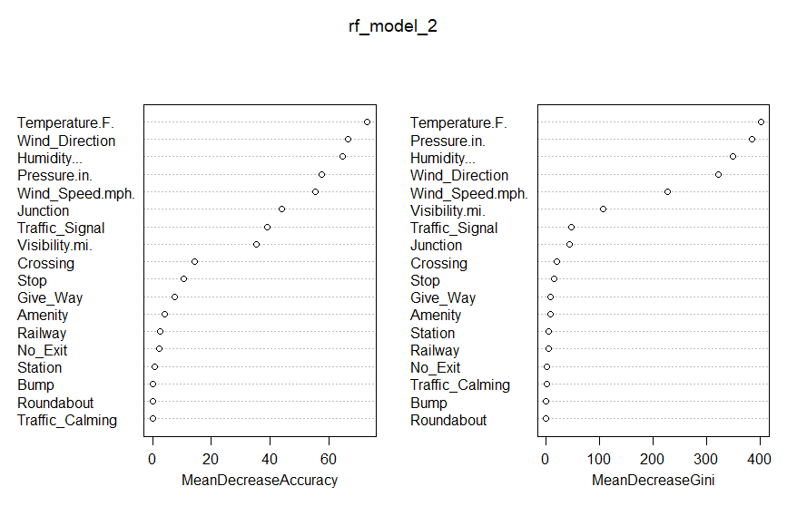
Classification Trees
Florida
Pennsylvania

Slide 23
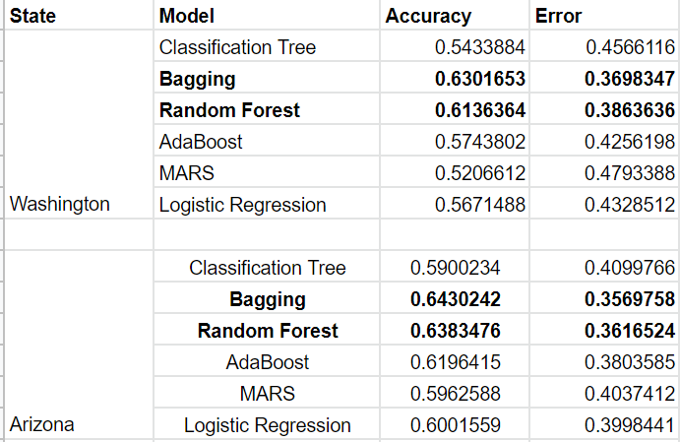
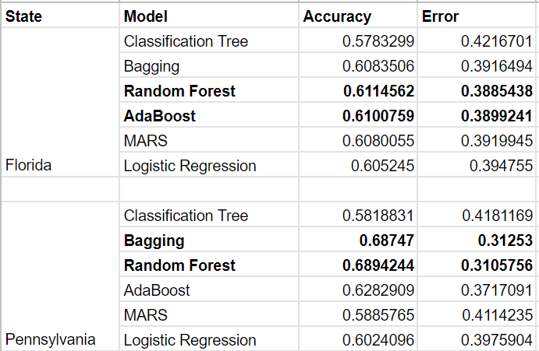
Predictive Accuracy

Slide 24
Conclusion and Future Work
A combination of Weather and Road POIs was found to be a very poor predictor of accident severity- contrary to several studies. Despite Weather variables dominating, accuracy remains fairly low.
Weather related variables were found to be the most important predictors across different states and Road POIs performed poorly in terms of variable importance (could be due to their sparsity).
Bagging and Random Forest ensemble were found to perform marginally better out-of-sample in this data, despite the use of models such as MARS and AdaBoost – they handle variance better.
Future direction – Studying driver behavior, eliminating driver behavior by studying autonomous vehicle crashes, topic modeling across insurance statements to understand driver/passenger understanding of the situation etc.
Notes:
https://mapchart.net/usa.html

Slide 25
Thank you

